Slide 1

CTEC 114 Technology innovation project
Genesis Grant

Slide 2

Solution Statement
Problem Statement
Have you ever spent the weekend or a Friday night thinking about what to do for fun? And NOTHING seemed to be happening. As college students, after a long week of homework, and/or finals and midterms, it is good to balance it out with a fun weekend! Was there ever any skill or extracurricular class that you wanted to participate in? Too many students, specifically at Bowie State University, believe that there is not enough happening on campus, events are short notice and/or they did not even know something was happening!
In order to help students find campus events, an app designed to alert and describe activities around campus will be useful. This app can be available in app stores and will give users descriptions and tracking/maps on where events will be held. The app will allow organizations and trusted users to post about events and students to be reminded and alerted when a new one is posted. It will use artificial intelligence to help answer questions about the app, locations, events, etc.

Slide 3
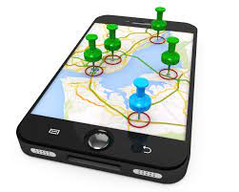
How?
- You and your friends went to the café to get dinner and now you guys want to go out and do something fun! Maybe a dance class or paint and sip. But, you have no idea what to do or where to go. They would just have to log onto the app and look at the available options.
- You are a commuter student and want to make friends! But you have no idea how or who to even approach. By looking on the app, you can see the different events. Using artificial intelligence, the app is able to recommend you to different events going on!

Slide 4
Important Details
Target Audience? College Students. Can be Bowie students or any students pertaining to their campus. The target audience size would be Bowie’s population which is around 6,000 – 7,000. But the app can be tailored towards other schools, with smaller or bigger populations.
Significance of Problem? Specifically at Bowie, I would say the problem is a 7-8/10. There are many instances where students may not know what is going on, on campus or don’t know where an event is etc. This will eliminate the struggle to find an event then an address then directions. It will all be in one app.
Solution Already Done? No! Social media is kind of catered towards spreading events, but some don’t follow pages and lots of times events are posted very late (maybe the day before or morning of).
Relevance? As college students, this app would be very relevant. It would be easily accessible on our phones and easy to use.

Slide 5
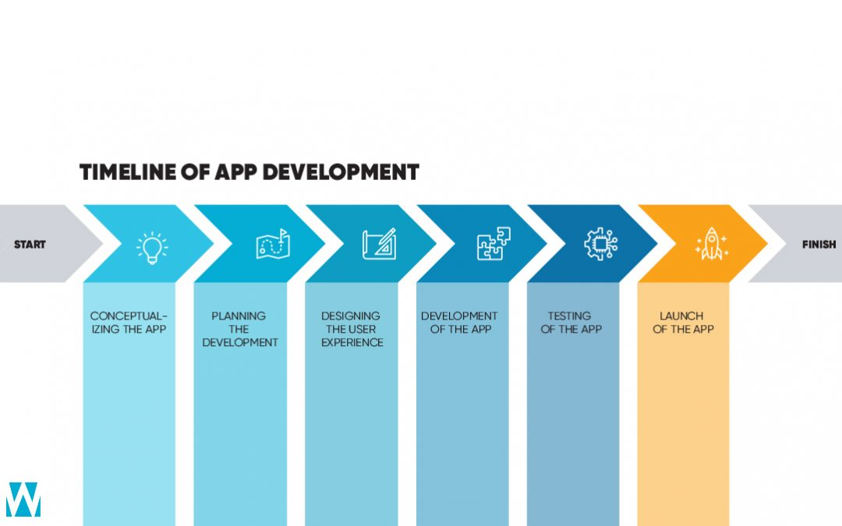
Important Details (cont.)
Potential Timeline? Around 6-7 weeks. This app seems very easy to make, it has simple processes and repeated functions.
Potential Costs? -------

Slide 6
Next steps for implementation
To continue on, I would have to learn more about which programming language would be best beneficial to begin the project as well as, how I would format the app. How users would be able to input information and how it would be visualized. After the design and developmental process, then would be testing prototypes and the final project.

Slide 7
Sources
Timeline of App Development. (2021). [Timeline]. WeSqaure IT SOLUTIONS. https://www.wesquare.nl/mobile-app-development-timeline-what-to-expect/
How Much Does It Cost To Make An App? (2020). APPLICO. https://www.applicoinc.com/blog/much-cost-build-app/
How to Start an App – 8 Steps You Must Take Before Starting Mobile App Development. (2020). Buildfire. https://buildfire.com/steps-before-starting-mobile-app-development/

